Slide 1
Bayesian Learning via Stochastic Gradient Langevin Dynamics
Gwangwoo Kim
Sep. 8, 2023

Slide 2





Introduction
Prior:
Likelihood:
Data:
Posterior:
The maximum a posteriori (MAP):

Slide 3

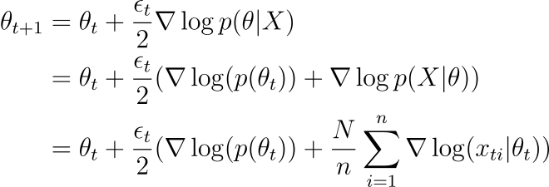
Introduction
One way to find the MAP is to use gradient descent (or ascent) with a mini-batch
Let be a min-batch at t iteration.

Slide 4

Introduction
To guarantee the convergence of gradient descent, we need
Unfortunately, the method does not capture true parameter uncertainty.

Slide 5

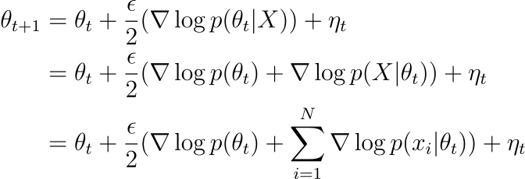

Introduction
(Unadjusted) Langevin algorithm is to sample from a target distribution as follows: For a target distribution ,
Where

Slide 6

Method
The proposed method not only finds an optimal theta, but also samples from the posterior distribution.

Slide 7
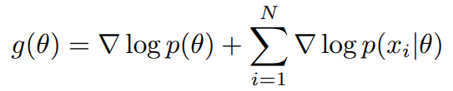
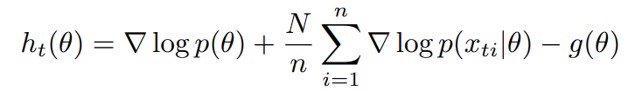

Method Analysis
Let
Then
Injected noise
Stochastic gradient noise

Slide 8


Method Analysis
Let , and let be a subsequence of such that
Otherwise, we would have

Slide 9


Method Analysis
Definitions (Stochastic big O notation):
If Xn is a sequence of random vectors, read this as
Source: Yvonne M. Bishop, Stephen E.Fienberg, Paul W. Holland. (1975,2007) Discrete multivariate analysis, Springer.

Slide 10



Method Analysis
Proposition: If Xn is a stochastic sequence with and
, then
(Proof) Use the Markov inequality
Source: Yvonne M. Bishop, Stephen E.Fienberg, Paul W. Holland. (1975,2007) Discrete multivariate analysis, Springer.

Slide 11

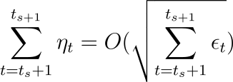

Method Analysis
Total injected noise between t_{s} and t_{s+1}:
By the previous proposition, we obtain
The noise will be

Slide 12

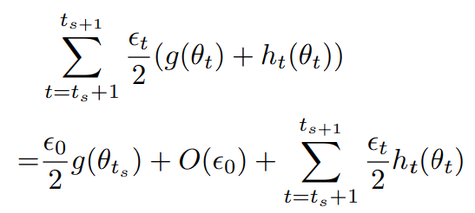
Method Analysis
For t between t_{s} and t_{s+1}, choose such that
Assume that the functions g are smooth (e.g. Lipschitz)
The total stochastic gradient is

Slide 13


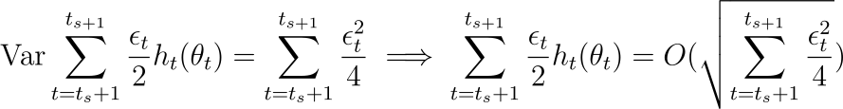
Method Analysis
Assume also that is iid (follows from random and independent choice of mini-batch)
Therefore,
Since the thetas did not vary much, we regard the variance as a constant and hence

Slide 14
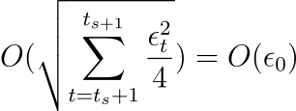

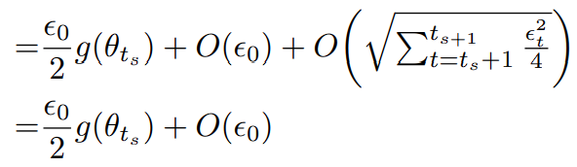
Method Analysis
Using the fact , we have
Finally, the total stochastic noise is given by

Slide 15


Method Analysis
Remark 1: the total stochastic noise is the gradient (from Langevin) with a deviation
Remark 2: That will be dominated by . This means that the sequence of theta’s will be samples from the posterior distribution.
Remark 3: The algorithm transitions smoothly between the gradient algorithm and Langevin sampling.
NB: To guarantee the algorithm to work it is important for the step sizes to decrease to zero. So the mixing rate of the algorithm will slow down.

Slide 16
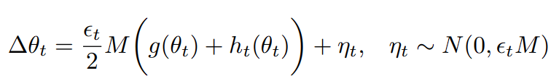
Sampling analysis
Preconditioning technique (Roberts & Stramer, 2002; Girolami & Calderhead, 2011)
Where M is a symmetric matrix
Then, the variance of the injected noise is
What about the stochastic noise?

Slide 17


Sampling analysis
Let
Then,

Slide 18
Sampling analysis
Let
Then,

Slide 19



Sampling analysis
If we want to get the injected noise to dominate the other one, we have an (informal) inequality:

Slide 20


Estimating Posterior Expectations
Since the sequence of theta’s converges to the posterior distribution,
However, as step size decreases, the mixing rate of the chain decreases as well. We propose to use the step sizes to weight the samples.

Slide 21
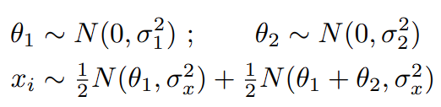

Experiments
Problem setup:
Batch = 1
Epoch = 10000
Step size : where a,b are chosen so that the size decreases from 0.01 to 0.0001.

Slide 22
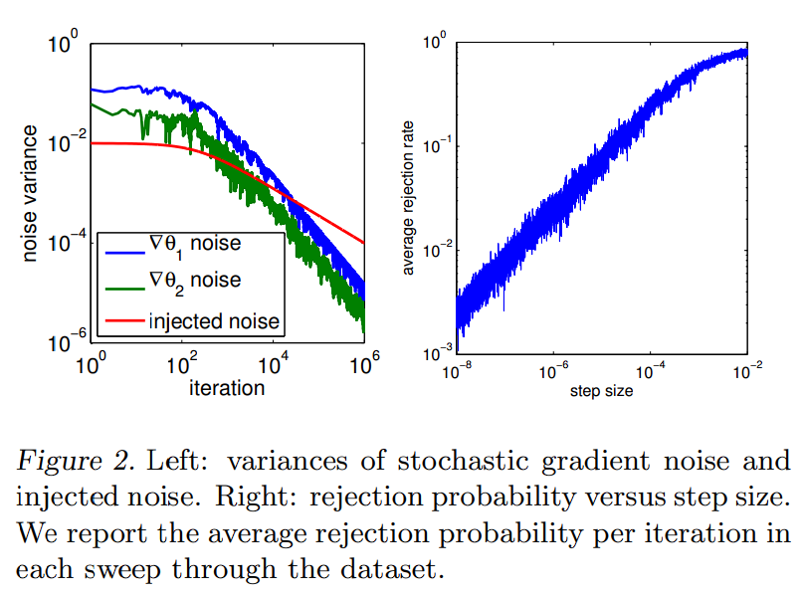
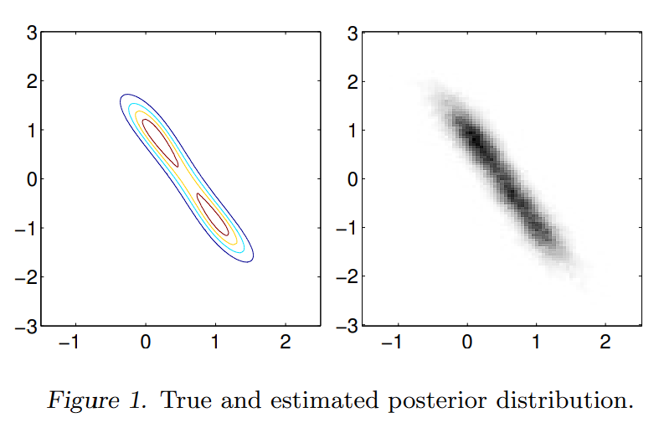
Experiments

Slide 23


Experiments
Problem setup:
Prior for beta:
32561 observations with 123 features
Batch size : 10
Run 50 times with the model trained on a random 80% of dataset and tested on 20%

Slide 24
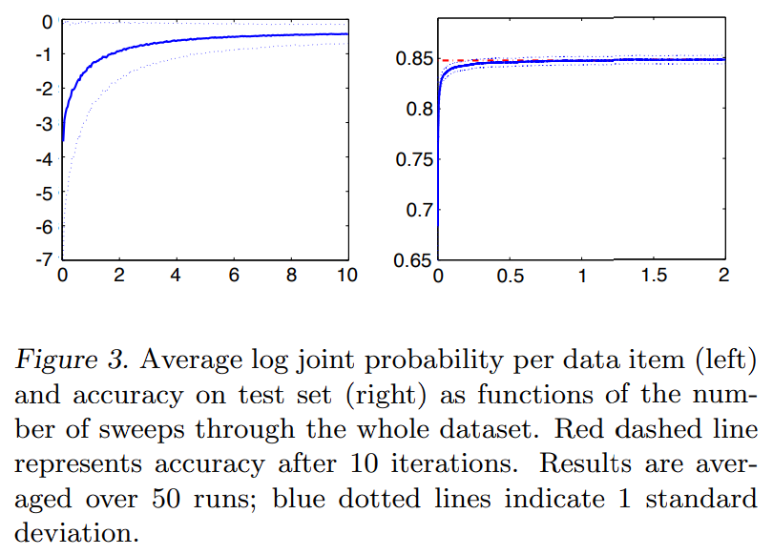
Experiments

Slide 25
Experiments
Independent Component Analysis (ICA) is omitted.

Slide 26
Points
Should not optimize beyond the scale of the posterior distribution.
MCMC algorithms need to see all the data, and lose the benefits of the stochastic approximation approaches.
With a polynomial annealing schedule the obtained samples will asymptotically represent the posterior distribution.

